Slide 1
MODULE 4

Slide 2
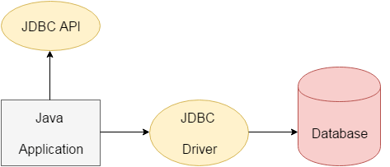
JDBC
Java Database Connectivity
It is a part of JavaSE (Java Standard Edition)
JDBC is a standard Java API for database-independent connectivity between the Java programming language and a wide range of databases.

Slide 3
API
Application Program Interface
a set of routines, protocols, and tools for building software applications

Slide 4
Why JDBC API ?
Connect to the database
Execute queries and update statements to the database
Retrieve the result received from the database.
To access tabular data stored in any relational database
To
Save
update
delete
fetch data from the database

Slide 5
JDBC API uses JDBC drivers to connect with the database.
JDBC is a Java API
to connect
to execute the query with the database.

Slide 6
Interfaces of JDBC API
Driver interface
Connection interface
Statement interface
PreparedStatement interface
CallableStatement interface
ResultSet interface
ResultSetMetaData interface
DatabaseMetaData interface
RowSet interface

Slide 7
Classes of JDBC API
DriverManager class
Blob class
Clob class
Types class

Slide 8
JDBC Applications
Java Applications
Java Applets
Java Servlets
Java ServerPages (JSPs)
Enterprise JavaBeans (EJBs).

Slide 9
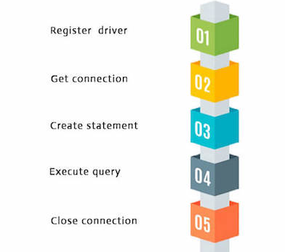
Steps in JDBC Connectivity
Notes:
CreateTable
InsertTable
Emp

Slide 10
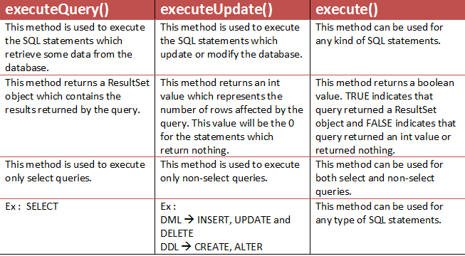

Slide 11
Metadata?

Slide 12
ResultSetMetaData Interface
Meta data about the ResultSet
Methods
getColumnCount
getColumnName
getColumnTypeName
getTableName
Notes:
RMetaData

Slide 13
PreparedStatement Interface
Used for parametrized queries
Can reuse new parameter values.
Increase performance of executed statements, as query is compiled only once .
Enables easier batch updates.
accepts input parameters at runtime.
Notes:
PStatement
PStatement1

Slide 14
Method | Description
public void setInt(int paramIndex, int value) | sets the integer value to the given parameter index.
public void setString(int paramIndex, String value) | sets the String value to the given parameter index.
public void setFloat(int paramIndex, float value) | sets the float value to the given parameter index.
public void setDouble(int paramIndex, double value) | sets the double value to the given parameter index.
public int executeUpdate() | executes the query. It is used for create, drop, insert, update, delete etc.
public ResultSet executeQuery() | executes the select query. It returns an instance of ResultSet.
Notes:
Callable

Slide 15
CallableStatement Interface
For Stored Procedures
SQL code that canbe saved
Reusablity
Parameter passing

Slide 16
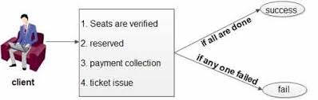
Transactions
a set of operations used to perform a particular task.
Notes:
commitDemo
commRoll

Slide 17
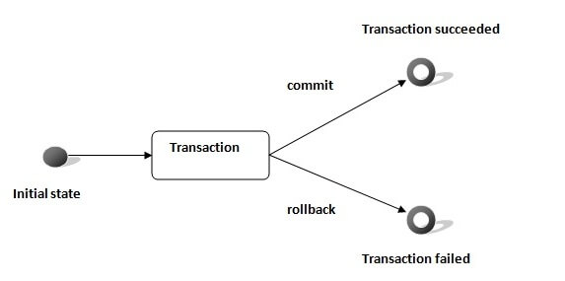
Transactions in JDBC

Slide 18
Method | Description
void setAutoCommit(boolean status) | It is true by default means each transaction is committed by default.
void commit() | commits the transaction.
void rollback() | cancels the transaction.
Notes:
setAutoCommit() method right after you open a connection to the database.
Once the auto-commit mode is set to false , you can commit or rollback the transaction.

Slide 19
Commit
permanently save the changes done in the transaction in tables
Unable to regain its previous state after the execution
When transaction is successful, COMMIT is applied

Slide 20
RollBack
to undo the transactions that have not been saved in database
to undo changes since the last COMMIT
When transaction is aborted, ROLLBACK occurs.

Slide 21
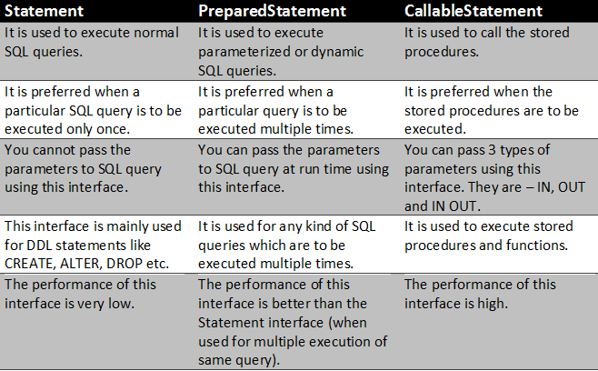

Slide 22
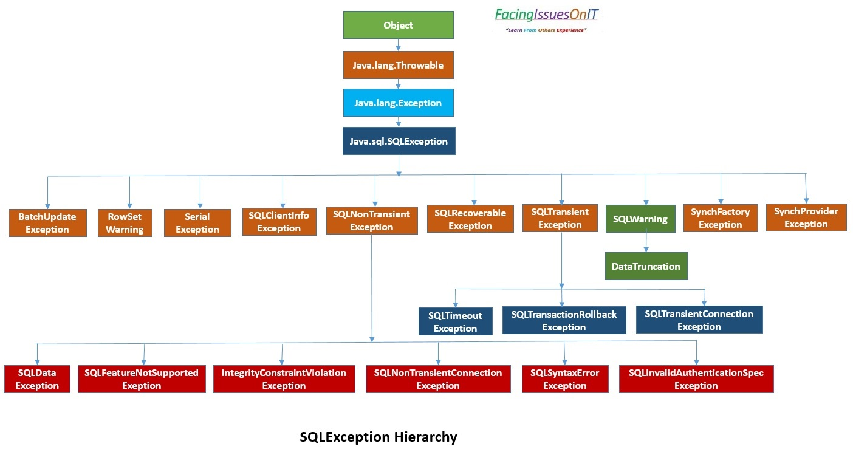
Exception Handling in JDBC

Slide 24
SQL Exceptions
Description of Error : It can be retrieved by SQLException.getMessage().
SQLStateCode : the method SQLException.getSQLState().
ErrorCode: the method SQLException.getErrorCode().
Exception Chaining: the method SQLException.getNextException() on the exception that was thrown.
Cause: the method SQLException.getCause() until a null value is returned.

Slide 25
SQL Exception SubClasses
BatchUpdateException
RowSetWarning
SerialException
SQLClientInfoException
SQLNonTransientException
SQLRecoverableException
SQLTransientException
SQLWarning
SynchFactoryException
SynchProviderException

Slide 26
SQL Warning
subclass of SQLException
deal with database access warnings.
Warnings do not stop the execution of an application
they simply alert the user that something did not happen as planned.
A warning can be reported
on a Connection object,
a Statement object (including PreparedStatement and CallableStatement objects),
or a ResultSet object.
getWarnings method
getWarnings returns a warning, → SQLWarning method getNextWarning on it to get any additional warnings.

Slide 27
DataTruncation warning
subclass of SQLWarning.
SQLState of 01004
indicating that there was a problem with reading or writing data.
methods let you find out
in which column or parameter data was truncated,
whether the truncation was on a read or write operation,
how many bytes should have been transferred, and
how many bytes were actually transferred.

